Slide 1
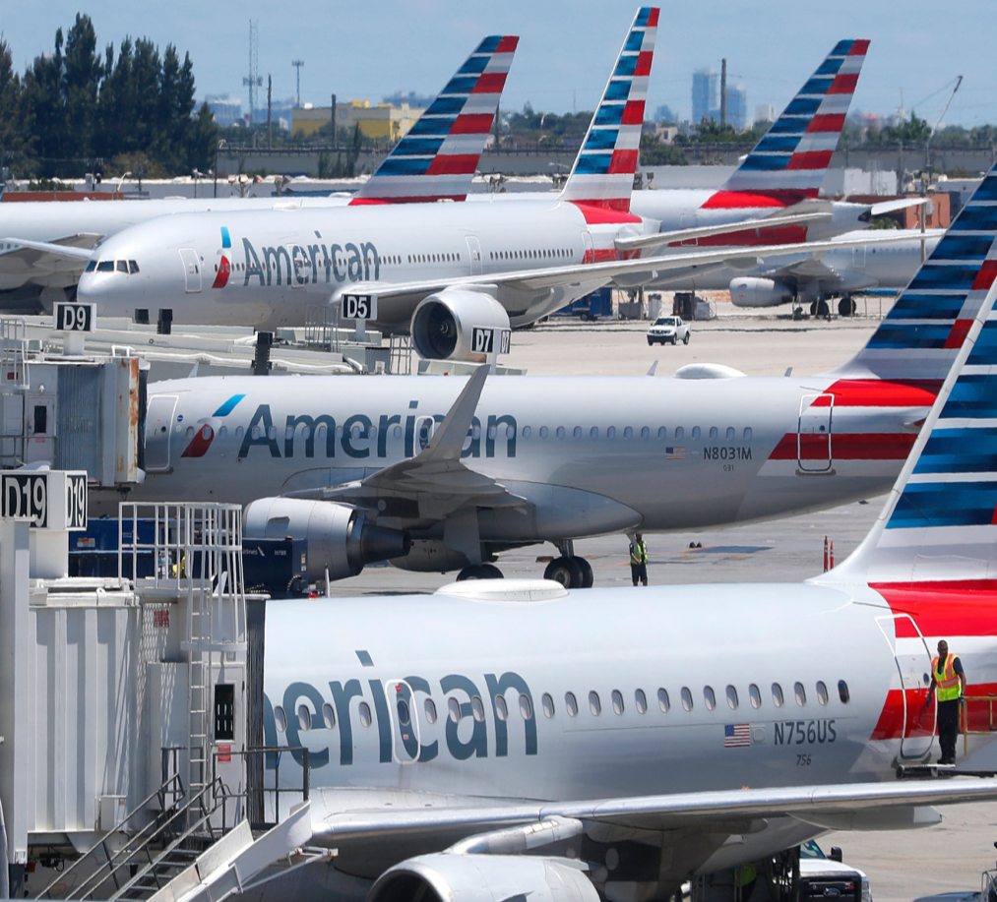
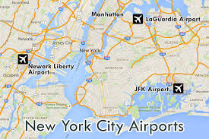
Analysis of flights from Newyork
Presented by : Sushil Kumar Thakur

Slide 2
Discussion points
Project Introduction
Description of Datasets
Handling Missing Data and required package
Problem statement and business question related to it.
Visualisation and it’s finding
Actionable insights
Conclusion

Slide 3
Projects Introduction
Topic: Analysis of flights operation from three airports of Newyork i.e EWR,JFK ,LGA
Source of Data: https://github.com/insaid2018/Term-1/blob/master/Data/Projects/NYC_Flight_Data.rar
Number of observation: 327346 and 18 variables
Source used 1. https://www.youtube.com/playlist?list=PLtPIclEQf-3cG31dxSMZ8KTcDG7zYng1j
2. https://seaborn.pydata.org/
3. https://aiquotient.app/
4. Earlier class notes and EDA.
5. Other data science website and https://www.geeksforgeeks.org/

Slide 4
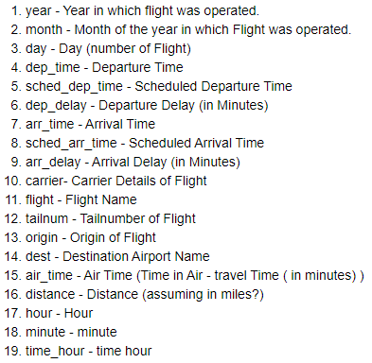
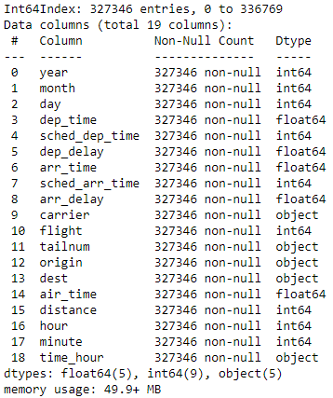
Description of Datasets
Description of Meat Data
Data Description for analysis

Slide 5
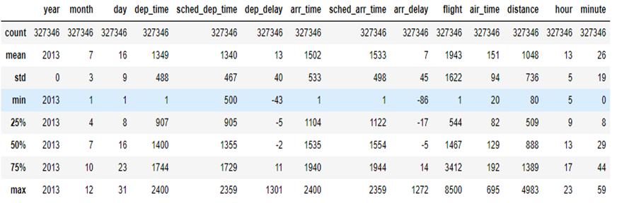
Description of Datasets
1.Total counts are 3,27,346 after cleaning and dropping the missing value.
2. Dataset is for year 2013 and 50 % of flights departure time is b/w 0907hrs to 1744 hrs.
3. In morning hours depart earlier than scheduled departure and arive earlier.
4. In office hours ,i.e b/w 0900 to 1800 hrs almost 50 % of flight operation .
5. Minimum flight operation in month of January and Maximum in Months of December.

Slide 6

Handling Missing Data and required package
Handling Missing Data
Required library
Name | Missing value
Departure_time | 8255
Departure delay | 8255
Arrival time | 8713
Arrival delay | 9430
Tailnum | 2512
Air_time | 9430
As our data is huge so we have dropped the missing value because we can’t predict any time or tailnumber of Aircraft.

Slide 7
Problem statement and business questions
Problem Statement : How often flights are operated and delayed from Newyork three airports i.e Newark, John F Kenndy and Lagguardia
Business Question :
1. What is count of Airlines flew fom Newyork in Year 2013 ?
2. What is % share of each airlines from Newyork ?
3. What is Count of flights operation from 3 Airports of Newyork and % share of each airport ?
4. What is distribution of departure time from 3 airports of Newyork ?
5. What is destination network from 3 airports ?
5. Count of flights headed towards top 10 Destination ?
6. Flights distribution from 3 airports of Newyork to top 10 destination ?
7. What is monthly departure and arrival delay by diffierent carrier ?
8. What is average departure and arrival delay by different carrier ?
9. More question

Slide 8
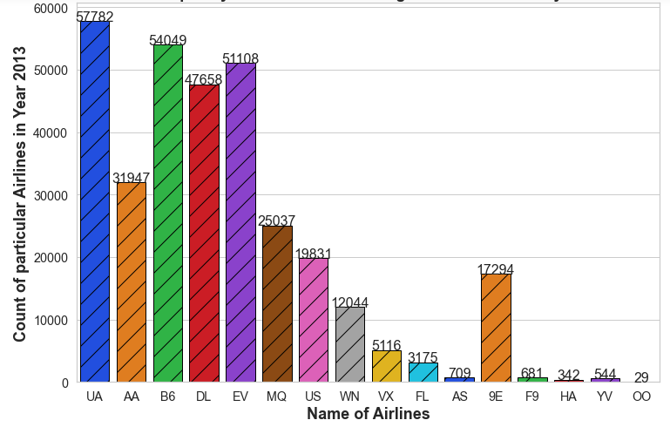
Count of Airlines flew from Newyork in year 2013
UA : United Air | AA : American | B6 : Jet Blue | DL : Delta
EV: Endeavour | MQ : Envoy Air | US : Us Air | WN: South west
VX : Northwest | FL : Air Leap | AS : ALASKA | 9E : Endeavour
F9 : Frontier | HA : Hawaii Air | YV : Avinca | OO : Skywest

Slide 9
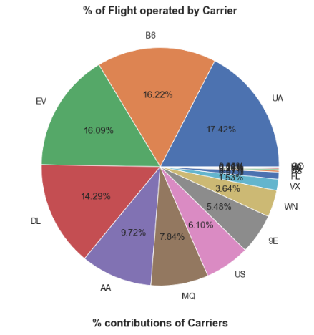
Share of each airlines from Newyork
Name | Airlines | % Share
UA | United Airline | 17.42
B6 | Jet Blue | 16.22
EV | Express Jet | 16.09
DL | Delta Airlines | 14.29
AA | American Airlines | 9.72
MQ | Envoy Air | 7.54
US | US Airways | 6.10
9E | Endeavor Air | 5.48
WN | Southwest Airlines | 3.64
Other | Other Airlines | 3.5

Slide 10
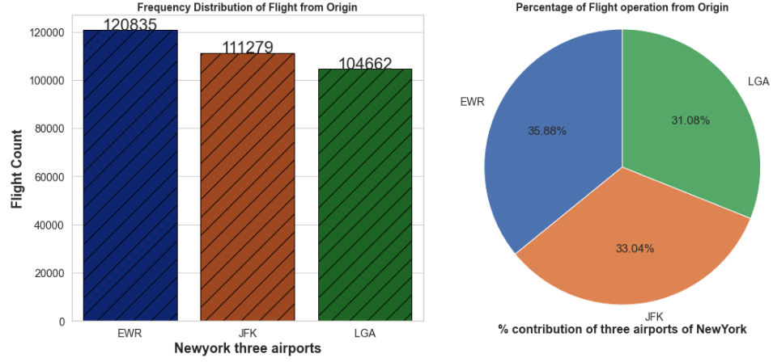
Count of flights operation from 3 Airports of Newyork and % share of each airports
Name Of Airports | Total count of flights | % of flights operation
EWR – Newark | 120385 | 36.88 %
JFK- John F Kennedy | 111279 | 33.04 %
LGA- La Guardia | 104662 | 31.08%

Slide 11
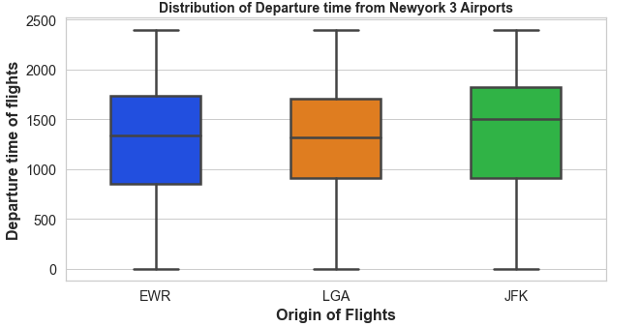
Distribution of departure time from 3 airports of Newyork
IQR is the highest for JFK (John F Kennedy) airport as 75% of flights are operating till 1800 hrs and median of departure is at 1500 hrs.
IQR of EWR airport is 0800 to 1700 hrs and LGA airport is 0900 to 1700 hrs.

Slide 12
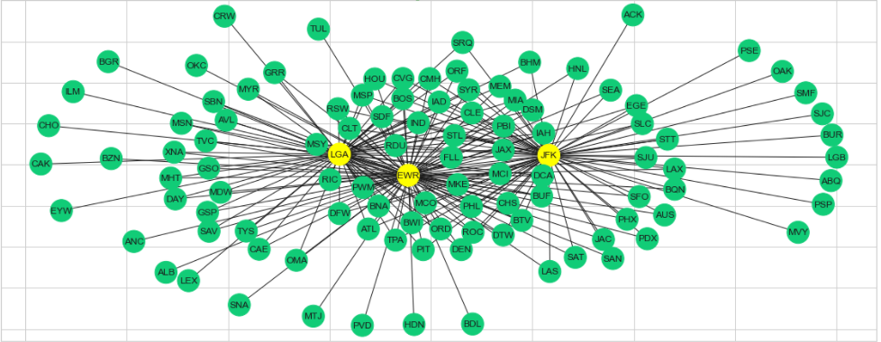
Destination information from all airports of Newwork
1. There are 120 unique destination which covers by all three airports of Newyork. The distance between EWR- JFK is 21 Miles and JFK to LGA is 13.24 miles and EwR to LGA is 17 miles. The distance covers is almost all major airport of USA.

Slide 13
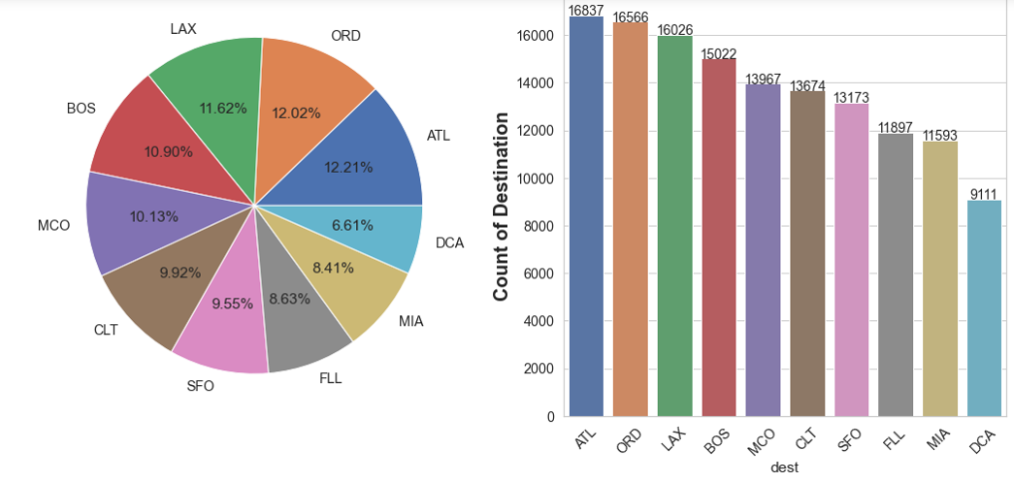
Count of flights headed towards top 10 destination from Newyork Airports
% contribution of flights in each destination
Count of flights for each destination
Top 10 destinations are ATL, (12.21%) ORD(12.02%) , LAX(11.62%),BOS(10.90%) ,MCO(10.13%),CLT(9.92%),SFO(9.55%),FLL(8.63%),MIA(8.41%) and DCA(6.61%).

Slide 14
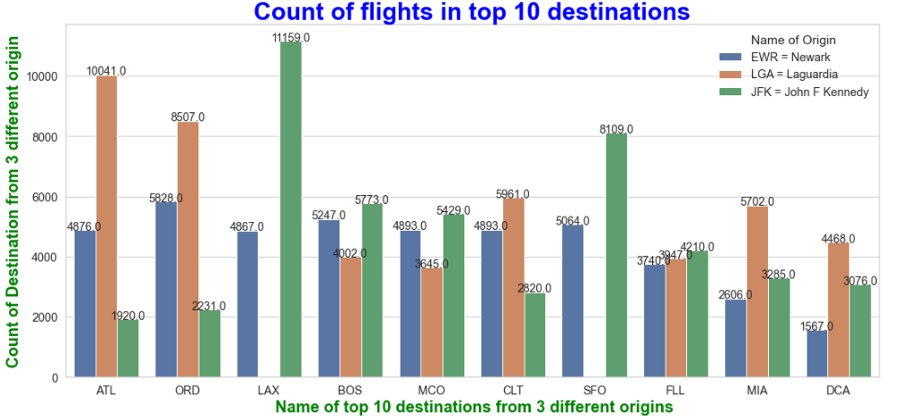
Flights distribution from 3 airports of Newyork to top 10 destination
Name | Total
ATL | 16837
ORD | 16566
LAX | 16026
BOS | 15022
MCO | 13967
CLT | 13674
SFO | 13173
FLL | 11897
MIA | 11593
DCA | 9111

Slide 15
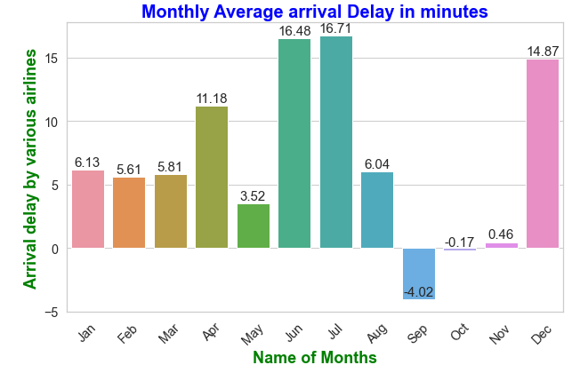
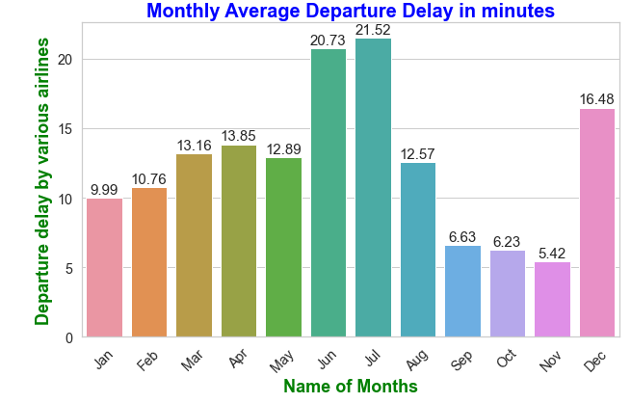
Monthly departure and arrival delay by different carrier

Slide 16
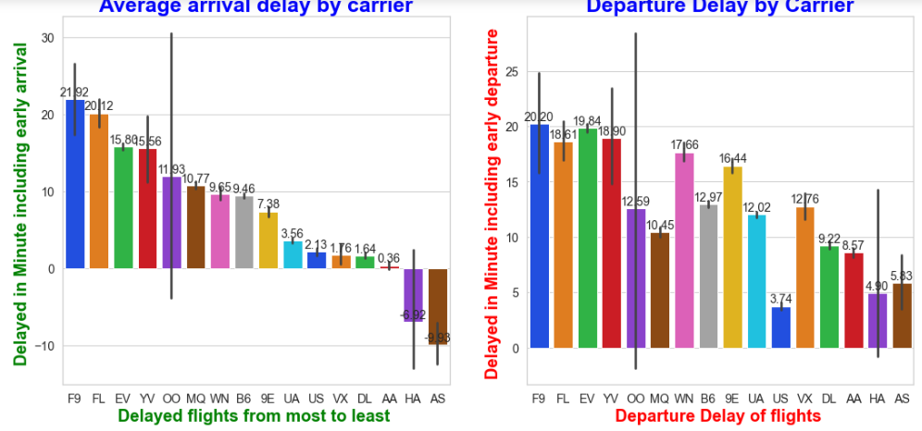
Average departure and arrival delay by different carrier
WN: Southwest Airlines', 'AA: American Airlines', 'MQ: American Eagle Airlines', 'UA: United Airlines', 'OO: Skywest Airlines', 'DL: Delta Airlines', 'US: US Airways', 'YV: Mesa Airlines', 'HA: Hawaiian Airlines', 'EV: Atlantic Southeast Airlines', 'FL: AirTran Airways', 'F9: Frontier Airlines', 'VX: Virgin America', 'B6: JetBlue Airways', '9E: Pinnacle Airlines', 'AS: Alaska Airlines'

Slide 17
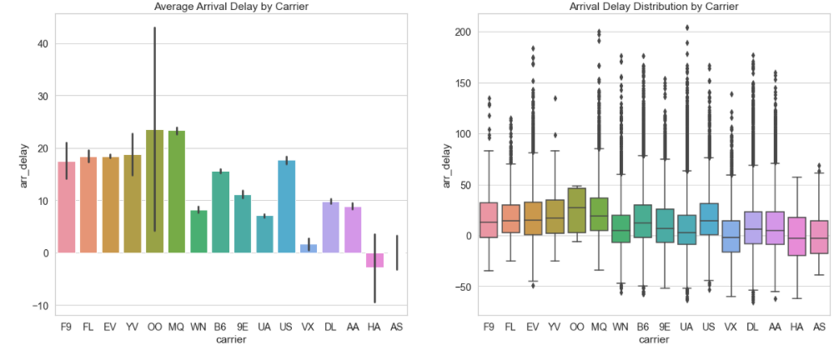
Average arrival delay and delay distribution by diffierent carrier
Carriers with higher average delay generation are
1. Skywest Airlines(OO) with 60 minutes per flight,
2. Mesa Airlines (YV) with 50 minutes per flight,
3. Pinnacle Airlines (9E) with 49 minutes per flight.
The boxplot shows, airlines with higher number of flights results having a higher chance of extreme waiting situation. American Eagle Airlines (MQ), American Airlines(AA), Delta Airline(DL) registered the maximum Carrier Delay for 2013 with an exception of Hawaiian Airlines (HA).

Slide 18
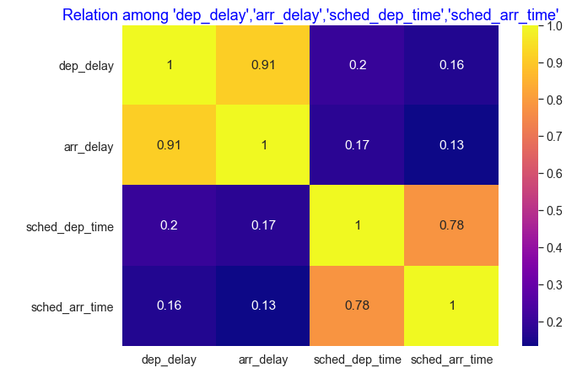
Relation among scheduled arrival , scheduled departure , departure delay and arrival delay
Correlation b/w dep_delay and arr_delay is 0.91 means highly correalated.
Scheduled departure time and scheduled arrival is also highly correlated as it’s value 0.78

Slide 19
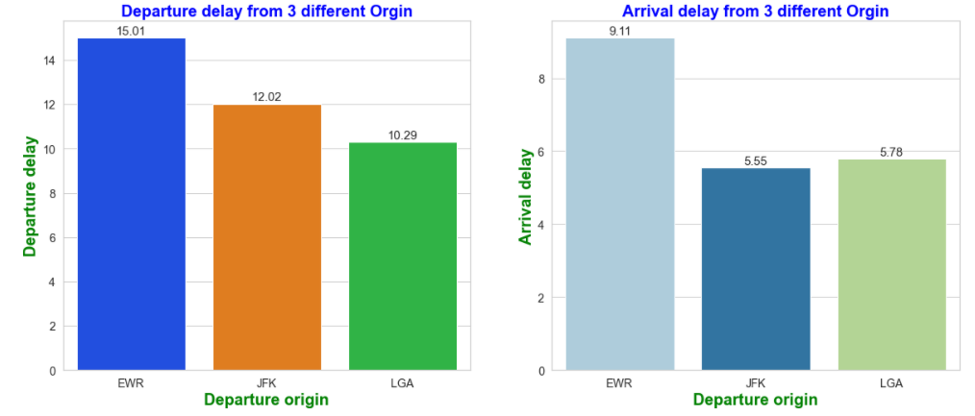
Average arrival and departure delay from 3 diffierent origin

Slide 20
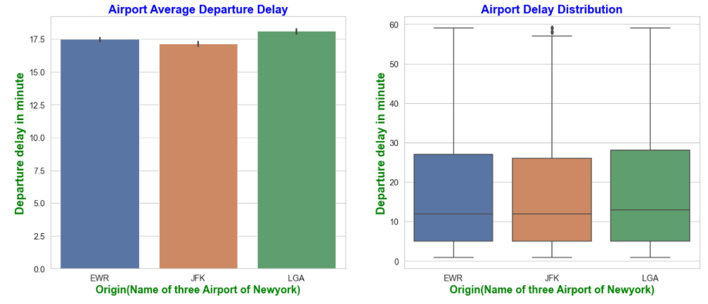
Average departure delay by carrier from 3 diffierent origin
There seems to be a correlation between the number of flights operated and departure delay.
A descending pattern can be seen from barplot for average departure delay per flight.
Considering, the assumption that JFK being a busiest airport among 3 due to international flights; so the maximum departure delay for 2013 is registered by JFK.

Slide 21
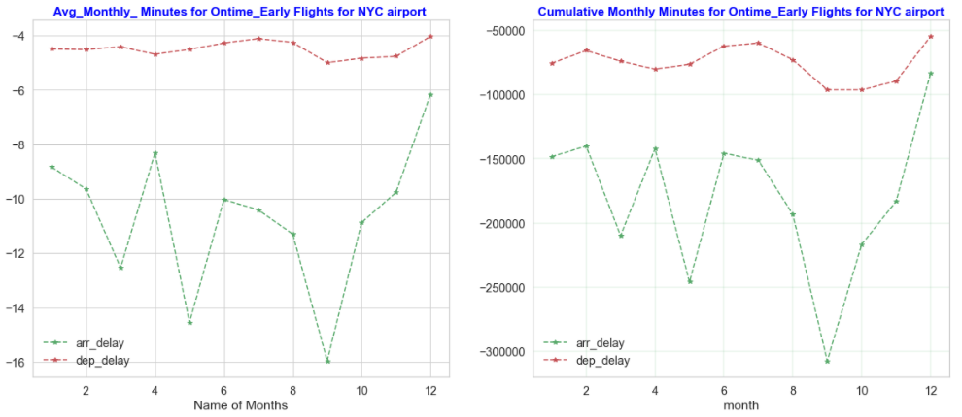
Average monthly delay of carrier and number of minute delayed in Months

Slide 22
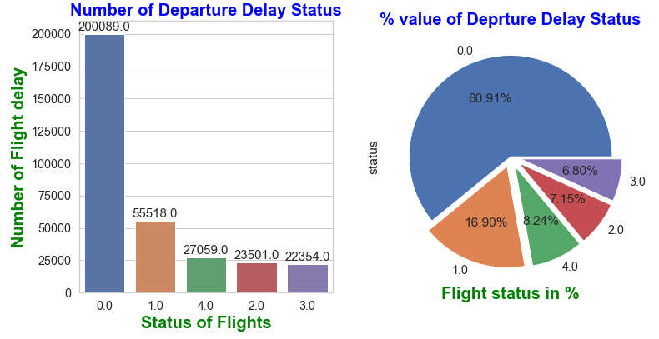
Ontime departure flights
Status | 0 | 1 | 2 | 3 | 4
Expression | <=0 min | >1 min | >15 min | >30 min | >60 min

Slide 23
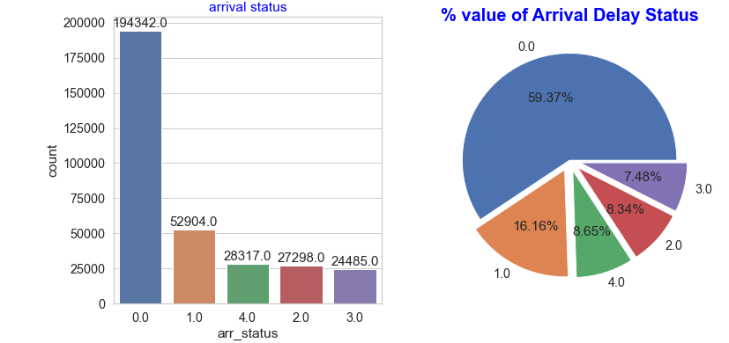
Ontime arrival flights

Slide 24
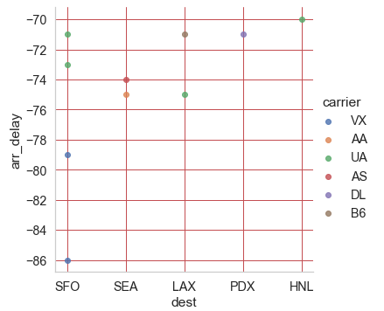
Top 5 destination where flights arrive earlier
Top 5 Destinations are
SFO- SanFrancisco
SEA - Seattle
LAX – Los Angeles
PDX- Portland
HNL - Honolulu
Top Carrier reaches to destination
VX – Virgin America
AA –American Airlines
UA – United Airlines
AS – Alaskan Air
DL – Delta Airlines
B6 – Jet Blue

Slide 25
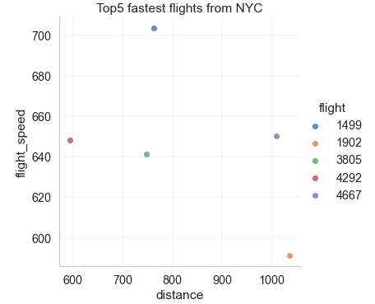
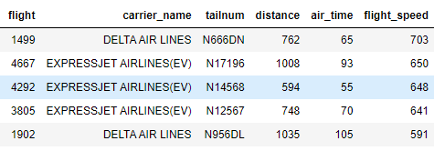
Top 5 fastest flight from Newyork

Slide 26
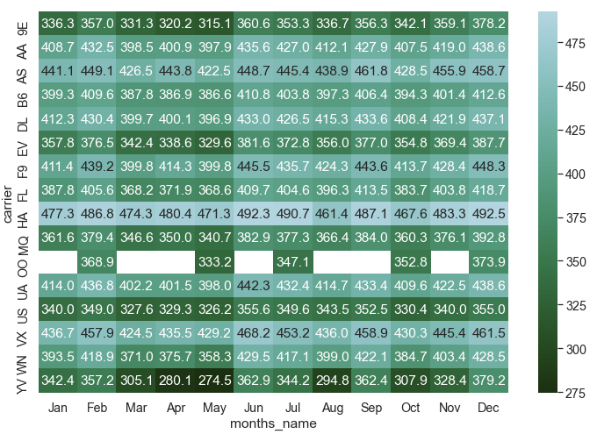
Information of Peak Season and lean seasonin USA
1. The peak season for air travel in USA is considered to be June to August
2. Lean season is mid of January to February.
3. From, the heatmap, it is visible that during May to August most of the airlines tend to fly faster than normal flight speed, to cover maximum departure. Whereas, it is vis-a-versa during lean season.')
4. The data proves that the statement is true and most of the airlines having maximum departure between May to August and minimum between January to February.

Slide 27
Actionable insight
As USA has a lot of famous destination which is untouchable from Newyork three airports.
As Laguardia is only domestic airport and rest other two i.e EWR and JFK is one of the busiest airport in the world so try to find scope one more domestic airport .
Almost 40% of flights are either late at time of departure or scheduled departure .
We need concentrate on flight schedule specially in peak hours.

Slide 28
Conclusion
1. The dataset doesn't offer reasons for delays and missing important data such as latitude and longitude, flight diversion, chocks on and off timing, and fuel consumption.
2. So, it is clear that the dataset doesn't provide clear understanding of delay issues, which may be supportive to look into delays that can be controlled or reduced.
3. For example: If airlines permits pilots to fly aircraft at higher speed and fuel consumption on planes that departed late, the delay spread can be minimize along the flight network. This would decrease the possible delay itself and significatively reduced the number of aircraft delays.
4. A solution applicable to one type of delay may affect the others, resulting in a ripple effect that will allow more efficient operations; benefiting passengers, airports, carriers and even the world as a whole.

Slide 29
End of Slides
BYE
Thank You

